Slide 1
MAY 2021
Celebrate Asian Pacific American Heritage Month with Dane County

Slide 2
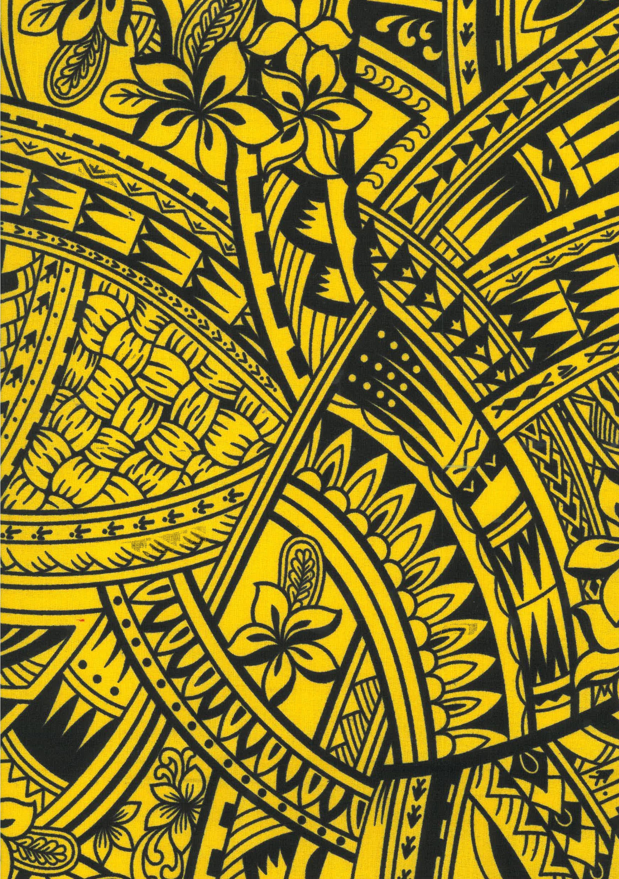
Asian American Pacific Islander Heritage Month
Asian American and Pacific Islander Heritage Month for the duration of month of May for recognizing the contributions and influences of Asian Americans and Pacific Island Americans to the history, culture, and varied achievements in the United States.

Slide 3
What Countries Make Up the Continent of Asia?
According to National Geographic Asia includes:
Afghanistan, Armenia, Azerbaijan, Bahrain, Bangladesh, Bhutan, Brunei, Cambodia, China, Georgia, India, Indonesia, Iran, Iraq, Israel, Japan, Jordan, Kazakhstan, Kuwait, Kyrgyzstan, Laos, Lebanon, Malaysia, Maldives, Mongolia, Myanmar (Burma), Nepal, North Korea, Oman, Pakistan, Philippines, Qatar, Russia, Saudi Arabia, Singapore, South Korea, Sri Lanka, Syria, Tajikistan, Thailand, Timor-Leste (East Timor), Turkey, Turkmenistan, United Arab Emirates, Uzbekistan, Vietnam, and Yemen.

Slide 4
Pacific Islanders
Pacific Islanders refer to those whose origins are the original peoples of Polynesia, Micronesia, and Melanesia. Polynesia includes Hawaii (Native Hawaiian), Samoa (Samoan), American Samoa (Samoan), Tokelau (Tokelauan), Tahiti (Tahitian), and Tonga (Tongan)
Cross-Cultural Center- California State University San Marcos
Map – Britannia

Slide 5
Breakdown by Location
East Asians refer to people from China (including Macau and Hong Kong), Korea, Japan, Okinawa, Taiwan, and Mongolia.
South Asians refer to people from the following countries: Bangladesh, Bhutan, India, the Maldives, Nepal, Pakistan, and Sri Lanka. Ethnic groups include Sindhi, Gujarati, Punjabi, Tamil, and many others.
Southeast Asians refer to people from the following countries and ethnic groups: Burma, Brunei, Cambodia (Khmer, Cham, KhmerLoeu), Indonesia, Laos (Hmong, Lao, Lao Loum, Iu Mien, Khmu, Tai Dam, Tai Leu, and many other ethnic groups), Malaysia, Singapore, Thailand, Timor-Leste, Philippines, and Vietnam (Vietnamese, Khmer Kampuchea Krom, Montagnards).
Pacific Islanders refer to those whose origins are the original peoples of Polynesia, Micronesia, and Melanesia. Polynesia includes Hawaii (Native Hawaiian), Samoa (Samoan), American Samoa (Samoan), Tokelau (Tokelauan), Tahiti (Tahitian), and Tonga (Tongan). Micronesia includes Guam (Guamanian or Chamorro), Mariana Islands (Mariana Islander), Saipan (Saipanese), Palau (Palauan), Yap (Yapanese), Chuuk (Chuukese), Pohnpei (Pohnpeian), Kosrae (Kosraean), Marshall Islands (Marshallese), and Kiribati (I-Kiribat). Melanesia includes Fiji (Fijian), Papau New Guinea (Papua New Guinean), Solomon Islands (Solomon Islander), and Vanuatu (Ni-Vanuatu).
Source - https://www.csusm.edu/ccc/programs/diaspora.html

Slide 6
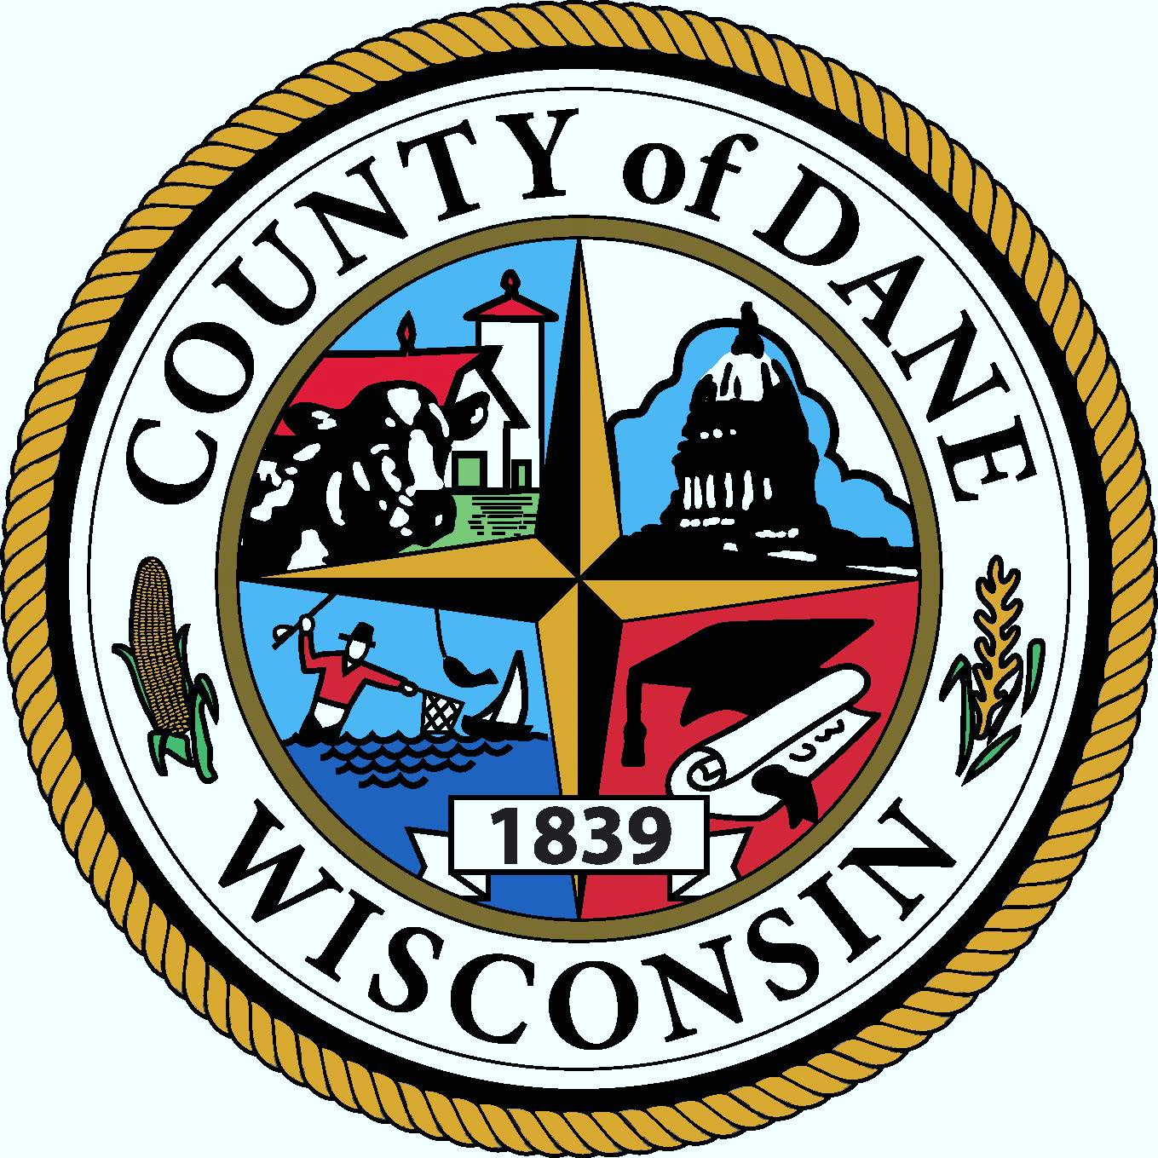
CELEBRATE AAPI HERITAGE MONTH WITH DANE COUNTY

