Slide 1
African Americans in Medicine and Health Care
Black history month

Slide 2
Overview of African Americans in the field of Medicine
African Americans in the United States have had a challenging relationship with the medical establishment. To say the least, African Americans have been non-trusting of the healthcare community, but this distrust is not without merit.
To understand the nature of suspicions of African Americans towards medical research and the health community in general, one just needs to look at history (Tuskegee Airmen, discrimination in the health care profession, and current data on the disparities in the African American community during the current COVID-19 Pandemic).
The African Americans who are spotlighted in this PowerPoint are pioneers in the medical profession. They withstood despite the odds against them and have opened the doors for current and future generations of African American medical professionals in the United States.
We pay respect and salute a few of these African American medical pioneers in this PowerPoint and thank them for persevering, their many contributions and for being an inspiration to us all.

Slide 3
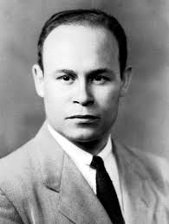
Dr. Charles Drew (1904 - 1950)
The Father of the Blood Bank
EDUCATION
Dr. Drew completed his bachelor's degree at Columbia University, Amherst College in 1926. In 1928, he enrolled at McGill University in Montreal, Canada. He was a member of the Alpha Omega Alpha, a medical honor society. Dr. Drew graduated from medical school in 1933 and was second in his class; he earned both Doctor of Medicine and Master of Surgery degrees.
ACCOMPLISHMENTS
Dr. Drew pioneered a method for processing and preserving blood plasma, or blood without cells. Plasma lasts much longer than whole blood, making it possible to be stored or "banked" for longer periods of time. He discovered that the plasma could be dried and then reconstituted when needed.

Slide 4
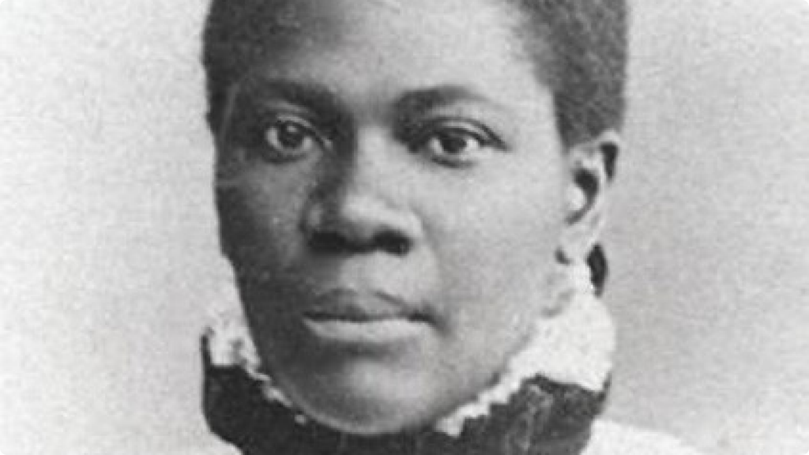
Dr. Rebecca Lee Crumpler (1831 - 1895)
First African American Female Physician in the U.S.
EDUCATION
Dr. Crumpler is the first African American female physician in the in the US to receive an MD from the New England Female Medical College in Boston, Massachusetts, 1864. She was the school’s first and only Black person to graduate from the school.
AUTHOR
Dr. Crumpler authored “A Book of Medical Discourses in Two Parts,” which was published by Cashman, Keating and Co., of Boston, in 1883. The book is divided into two sections: The first part focuses on “treating the cause, prevention, and cure of infantile bowel complaints, from birth to the close of the teething period, or after the fifth year.”
The second section contains “miscellaneous information concerning the life and growth of beings; the beginning of womanhood; also, the cause, prevention, and cure of many of the most distressing complaints of women, and youth of both sexes.”

Slide 5
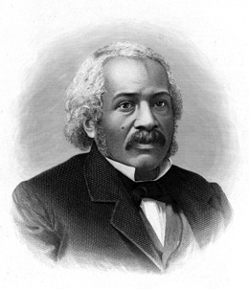
Dr. James McCune Smith (1813 - 1865)
The First African American to Receive a Medical Degree
EDUCATION
Dr. James McCune Smith was a graduate of the New York African Free School. Unable to attend college in the United States because due to discrimination, Smith entered Glasgow University in Scotland. There he graduated at the top of his class and earned three academic degrees. He received his Bachelor of Arts (1835), Master of Art (1836), and Medical Doctor (1837) degree.
ACCOMPLISHMENTS
Dr. Smith was also an apothecary. He was the first African American to own and operate a pharmacy in the US and be published in the US Medical Journals. He used his training in medicine and statistics to refute common misconceptions about race, intelligence, medicine, and society. In 1852, he was invited to be a founding member of the New Your Statistic Society which promoted a new science; in 1854, elected for membership to the American Geographic Society. Dr. Smith was a published author whose works include: A Lecture on the Haitian Revolution (1841), The Destiny of the People of Color (1843), A biographical introduction to Henry Highland Garnet's A Memorial Discourse and The introduction to Frederick Douglass' My Bondage and My Freedom.

Slide 6
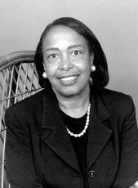
Dr. Patricia Bath (1942 - 2019)
  First Black Female Physician Awarded a Medical Patent
  EDUCATION
  Dr. Bath received her BA in Chemistry from Hunter College in 1964. She then enrolled and graduated from Howard University College of Medicine in Washington D.C.
  ACCOMPLISHMENTS
  Dr. Bath was a pioneer in visual research in the African American Community and is the co-founder of the Institute for Prevention of Blindness. She was the first woman appointed as the Chair of Ophthalmology at UC Los Angeles David Geffen School of Medicine in 1983.
  INVENTIONS
  Dr. Bath invented and received a patent on May 17, 1988 for a device and technique for cataract surgery known as Laserphaco Probe which is short for laser photoablative cataract surgery. The device restored the sight of thousands of patients who were blind for years. Dr. Bath stated, ““The ability to restore sight is the ultimate reward.”

Slide 7
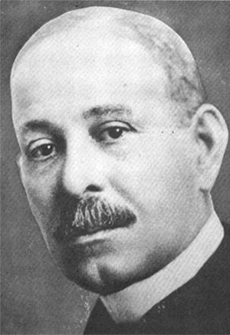
Dr. Daniel Hale Williams (1858 - 1931)
The First Black Cardiologist to Successfully Complete Open Heart Surgeon on a Patient
EDUCATION
Dr. Williams received his medical degree from the Chicago School of Medicine.
ACCOMPLISHMENTS
Dr. Williams was the first Black anatomy instructor at Chicago Medical College. He successfully performed an open-heart surgery on a patient. He was a co-founder of the National Medical Association and was a charter member of the American College of Surgeons. He founded the first interracial and black-owned hospital. Dr. Williams opened Provident Hospital and Nursing Training School in Chicago. Provident was the first medical facility with an interracial staff. Among his many honors, he was named the American College of Surgeons first Black fellow. Williams later became chief surgeon of the Freedmen’s Hospital in Washington D.C.

Slide 8
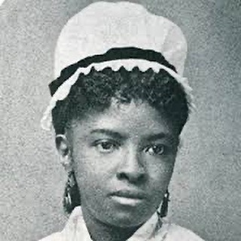
Mary Eliza Mahoney, RN (1845 - 1926)
First African American Licensed Nurse in the U.S.
EDUCATION
In 1878, at the age of 33, Mahoney was admitted to the hospital’s professional graduate school for nursing the New England Hospital for Women and Children's Training School. Of the 42 students that entered the program in 1878, only four completed it in 1879, and Nurse Mahoney was one of the four.
ACCOMPLISHMENT
Nurse Mahoney became one of the first black members of the American Nurses Association. In 1908, she co-founded the National Association of Colored Graduate Nurses (NACGN). In 1993, she was inducted into the National Women’s Hall of Fame in Seneca Falls, New York.

Slide 9
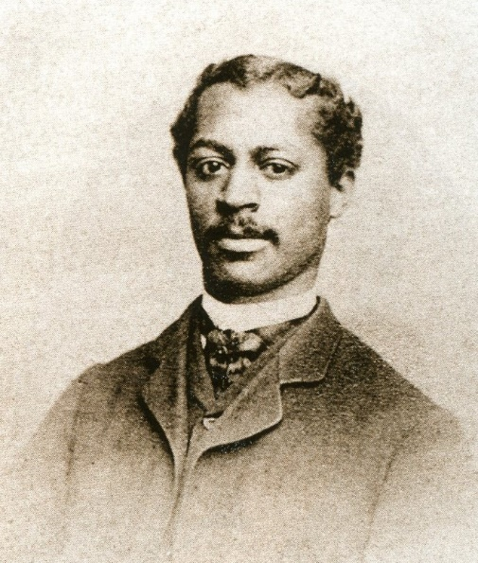
Dr. Robert Tanner Freeman, DDS - (1846 - 1873)
The First African American to graduate with a Dental Degree in the U.S.
EDUCATION
Dr. Freeman along with Dr. George Franklin Grant became the first African Americans to enroll in Harvard University Dental School in 1867. Dr. Freeman was 21 years of age when he enrolled. He graduated only four years after the end of the Civil War on May 18, 1869. Dr. Franklin graduated the following year in 1870.
LIFE
Born the son of slaves in 1846, as a child, Dr. Freeman befriended Henry Bliss Noble, a local white dentist in the District of Columbia who encouraged him to apply for dental school. Unfortunately, only four years after he received his dental school degree, Dr. Freeman passed away in 1873.

Slide 10
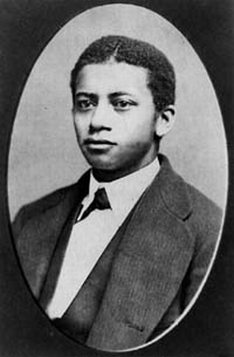
Dr. George Franklin Grant, DDS (1847 - 1910)
One of Two of the First African Americans to Enroll in the Inaugural Class at Harvard Dental School
EDUCATION
Dr. Grant along with Dr. Robert Tanner Freeman became the first African Americans to enroll in Harvard University Dental School in 1867. Dr. Franklin graduated in 1870 from Harvard Dental School, a year after Dr. Freeman.
ACCOMPLISHMENTS
Dr. Grant became the first African American faculty member at Harvard, in the School of Mechanical Dentistry, where he served for 19 years. His specialty was helping individuals born with a cleft palate. He was a founder and president of the Harvard Odonatological Society. Beginning in 1881, he served as President of the Harvard Dental Association.
INVENTIONS
Dr. Grant invented and patented a prosthetic device that allowed patients to speak more normally.
Dr. Grant invented and patented the golf tee in 1889. The tee was whittled from wood and capped with a latex resin that was used in dentistry for root canals.

Slide 11
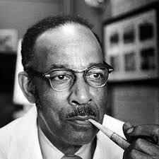
Dr. Vivien Thomas (1910 – 1985)
EDUCATION
Vivien Thomas is a graduate of Pearl High School in Nashville, TN. He wanted to study medicine and become a doctor. He enrolled at the Tennessee Agricultural and Industrial College (Tennessee State University, Nashville, TN) as a premedical student. When the United States entered the Great Depression, this caused him to put his plans on hold.
CAREER
In 1930, Vivien Thomas secured a job as surgical research assistant with Dr. Alfred Blalock at Vanderbilt University. The two conducted groundbreaking research on the causes of hemorrhagic[ and traumatic shock Blalock, with the assistance of Thomas, disproved that shock was caused by toxins in the blood. The work Blalock and Thomas did made Blalock a pioneer in American surgery. In 1941,Blalock was offered the position of Chief of Surgery Johns Hopkins where he attended Medical College. Blalock requested that Thomas be able to accompany him to the University.
LEGACY
Despite not having a medical degree, Dr. Thomas became a cardiac surgery pioneer and a teacher of operative techniques to many prominent surgeons. John Hopkins presented Vivien Thomas with an honorary Doctor of Law Degree In 1976. Dr. Thomas was appointed to the faculty of the School of Medicine as Instructor of Surgery after working there for 37 years; however, he was never allowed to operate on a living patient. In 2005, Johns Hopkins School of Medicine began splitting incoming first-year students into four colleges, each named for famous Hopkins faculty members who had major impacts on the history of medicine. Thomas was chosen as one of the four.
His life story was memorialize in the HBO movie “Something the Lord Made.”

Slide 12
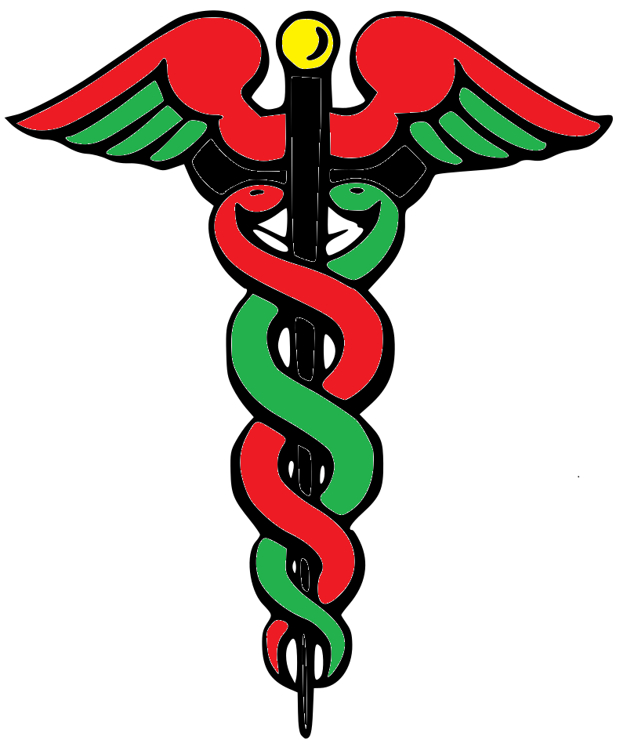
AFRICAN AMERICANS IN MEDICINE AND HEALTHCARE FACTOID
BLACK MEDICAL COLLEGES
There are four historically Black medical schools in the United States.
Meharry Medical College (Meharry), the oldest and located in Nashville, Tennessee
Howard University College of Medicine (Howard), located in Washington D.C.
Morehouse School of Medicine (Morehouse), located in Atlanta Georgia and
Charles R. Drew University of Medicine and Science, located in Los Angeles, California

Slide 13
READING RESOURCES
BOOKS
Medical Bondage - Race, Gender, and the Origins of American Gynecology by Deidra Cooper Owens
The Immortal Life of Henrietta Lacks by Rebecca Skloot.
Black Man in a White Coat: A Doctor's Reflections on Race and Medicine by Damon Tweedy, MD
The Pact: Three Young Men Make a Promise and Fulfill a Dream by Dr. Sampson Davis Dr. George Jenkins and Dr. Rameck
LINKS
https://www.ama-assn.org/about/ama-history/history-african-americans-and-organized-medicine
https://guides.mclibrary.duke.edu/blackhistorymonth/chronology
https://tcf.org/content/report/racism-inequality-health-care-african-americans/?agreed=1
https://www.americanbar.org/groups/crsj/publications/human_rights_magazine_home/the-state-of-healthcare-in-the-united-states/racial-disparities-in-health-care/

